Slide 1
ELG3336: Electronics for Mechanical Engineering
Professor:
Riadh Habash, PhD, P.Eng
TA: Nader N. Joojili
Email: nnase063@uottawa.ca
Office: 4073 – Site Building

Slide 2
Agenda
Introduction
Design Module 1:
IoT-based Data Acquisition System for a Mechatronics System

Slide 3
About me!
Bachelor’s in Computer Hardware Engineering
Master Artificial Intelligence
Master Information Technology (Carleton)
P.h.D Candidate at the University of Ottawa
Interest:
Deep Learning
Signal Processing
Quantum ML
Reinforcement Learning

Slide 4
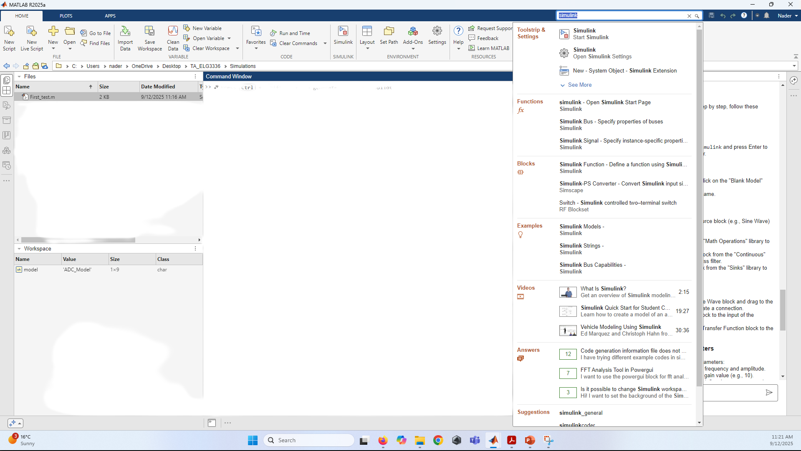
Step 1: Open Simulink
Launch MATLAB.
In the Command Window, type Simulink and press Enter to open the Simulink Library Browser.

Slide 5
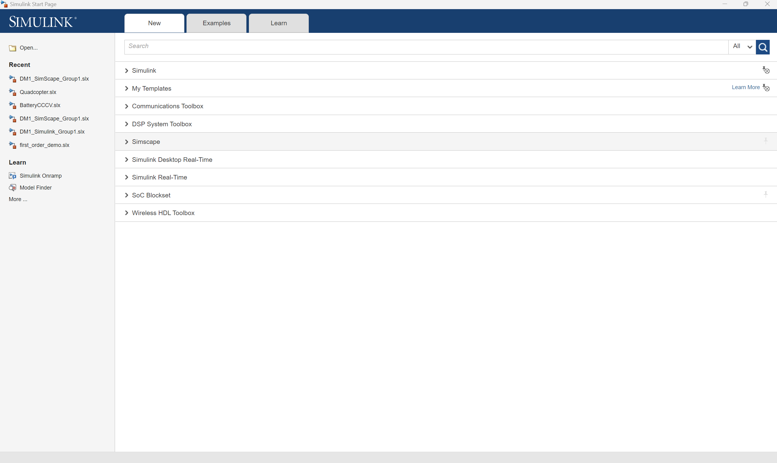
Step 2: Create a New Model
In the Simulink Library Browser, click on the "Blank Model" option to create a new model.
Save your model with a suitable name. (Do not use a number in the first, it must start with eligible character)

Slide 6
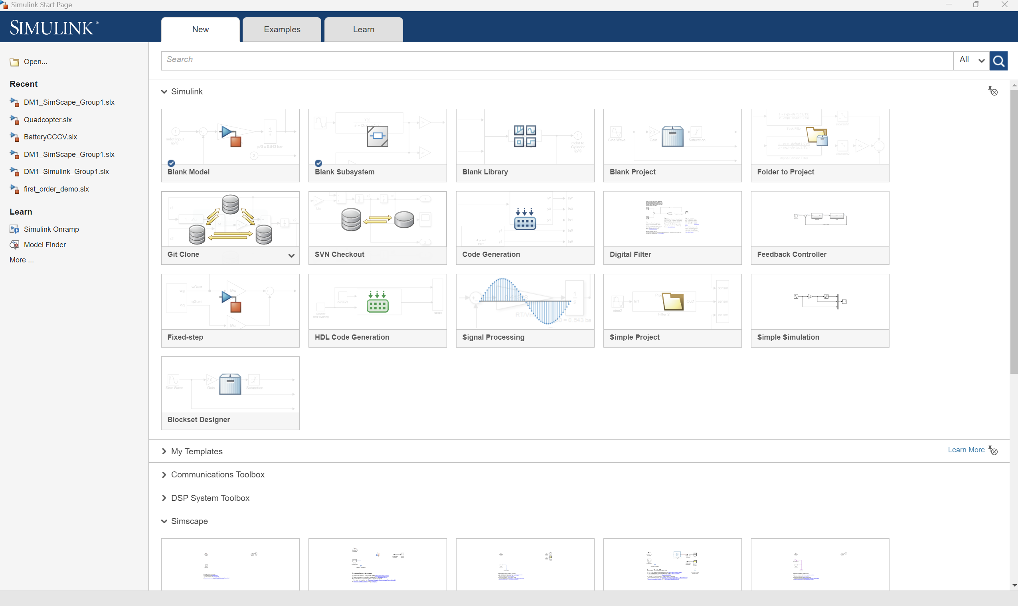
Simulink

Slide 7
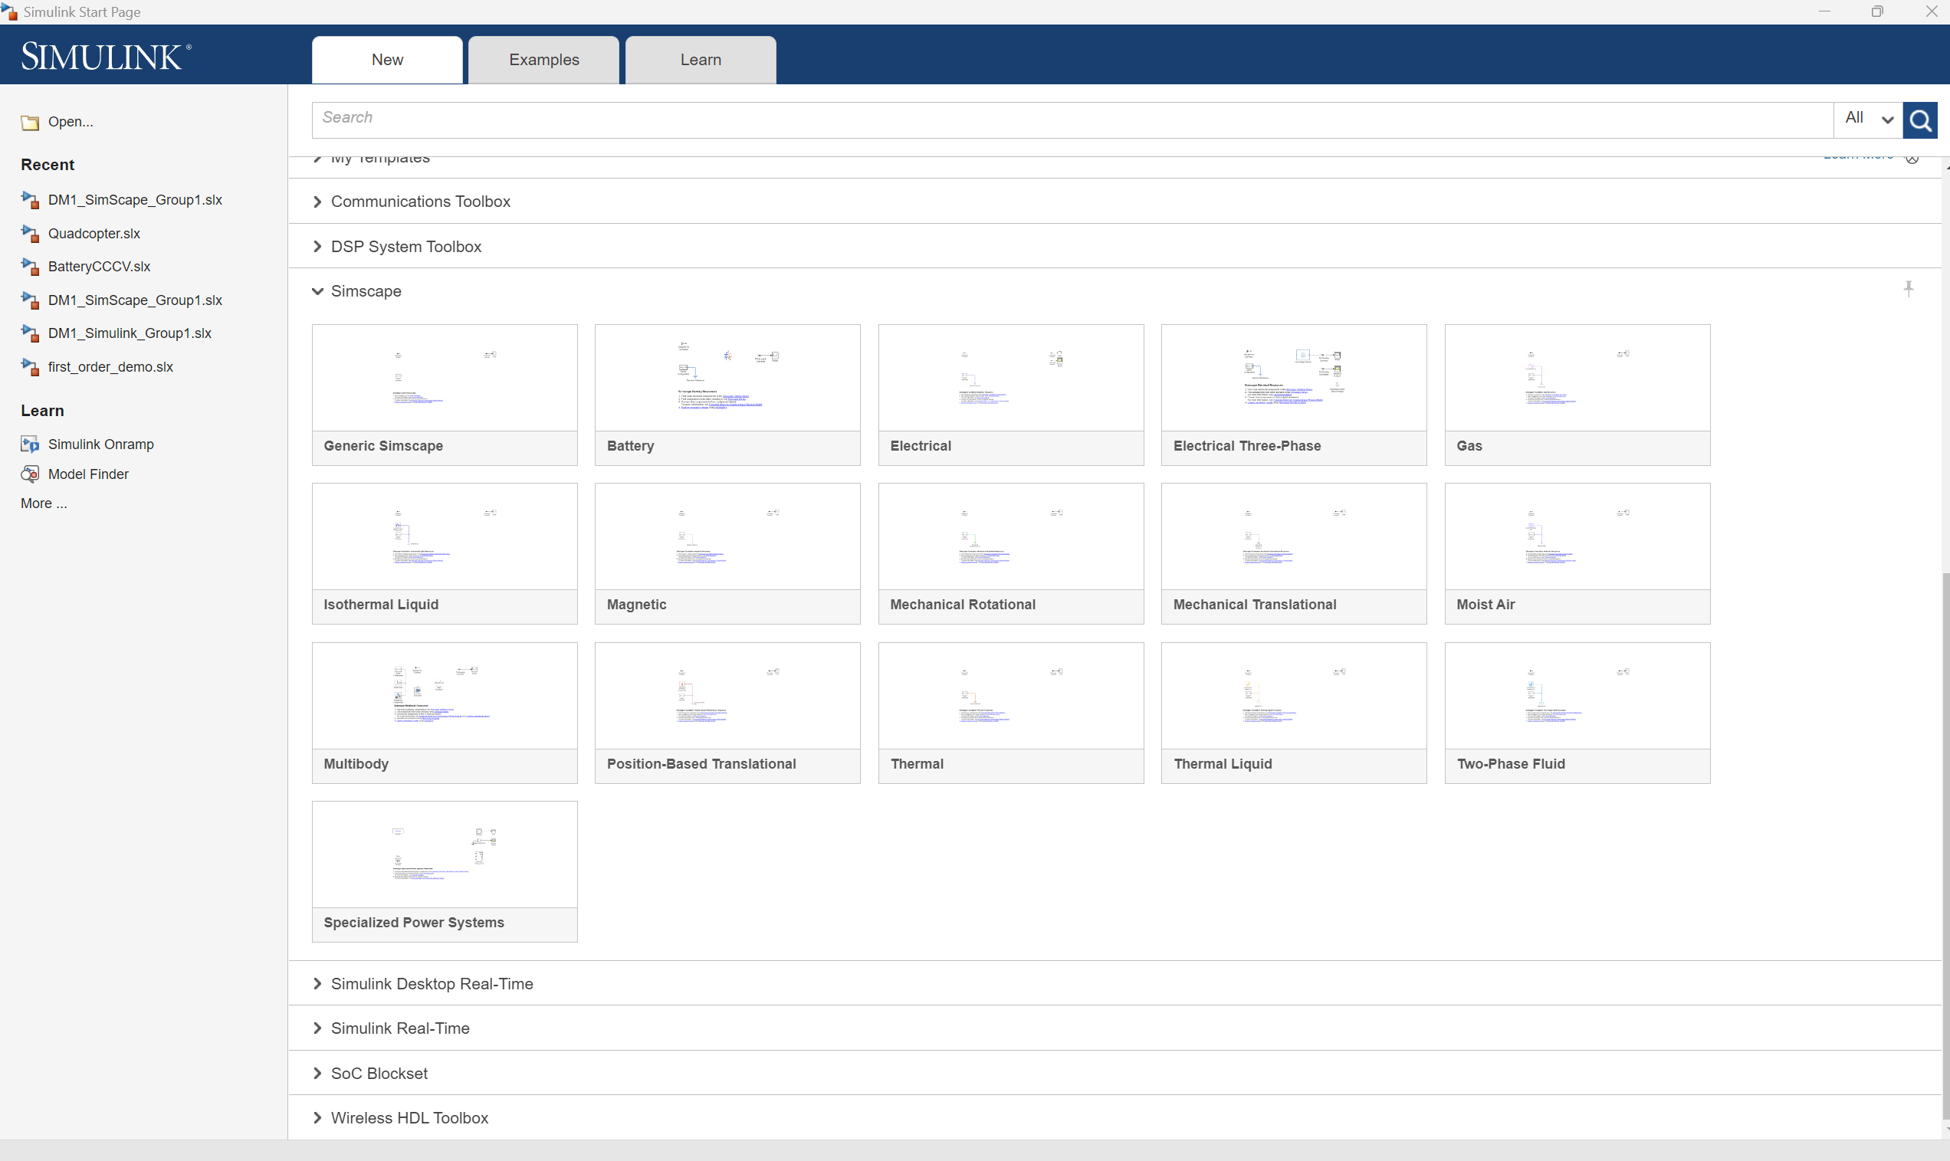
Simulink

Slide 8
Step 3: Add Blocks
Input Block: Drag and drop a source block (e.g., Sine Wave) from the "Sources" library.
Signal Conditioning Blocks:
Add a Gain block from the "Math Operations" library to amplify the signal.
Add a Transfer Function block from the "Continuous" library to simulate a low-pass filter.
Output Block: Add a Scope block from the "Sinks" library to visualize the output.

Slide 9
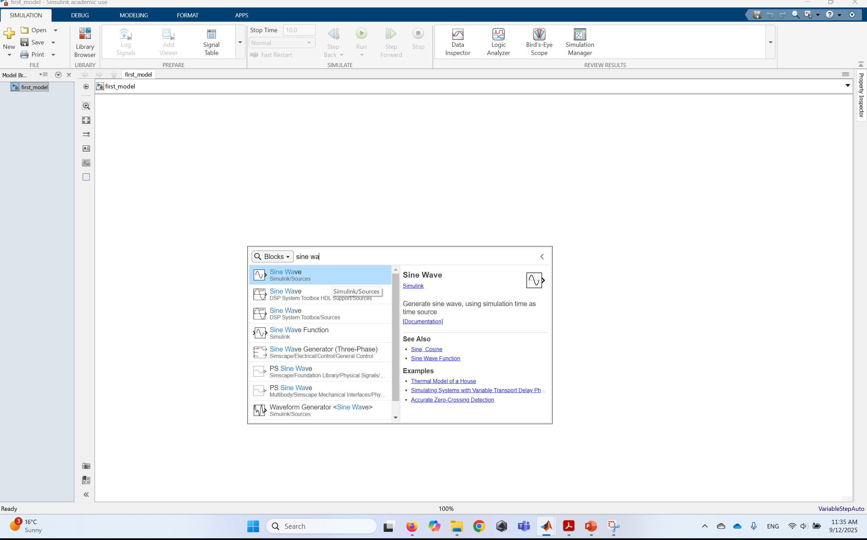
Step 3: Add Blocks
Input Block: Drag and drop a source block (e.g., Sine Wave) from the "Sources" library.

Slide 10
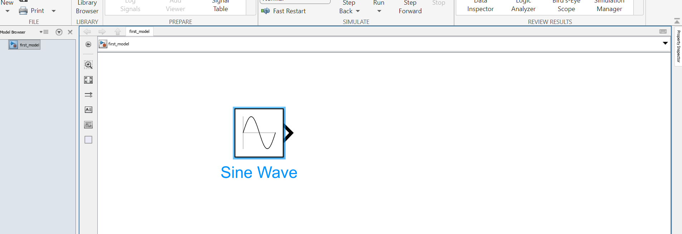
Step 3: Add Blocks

Slide 11
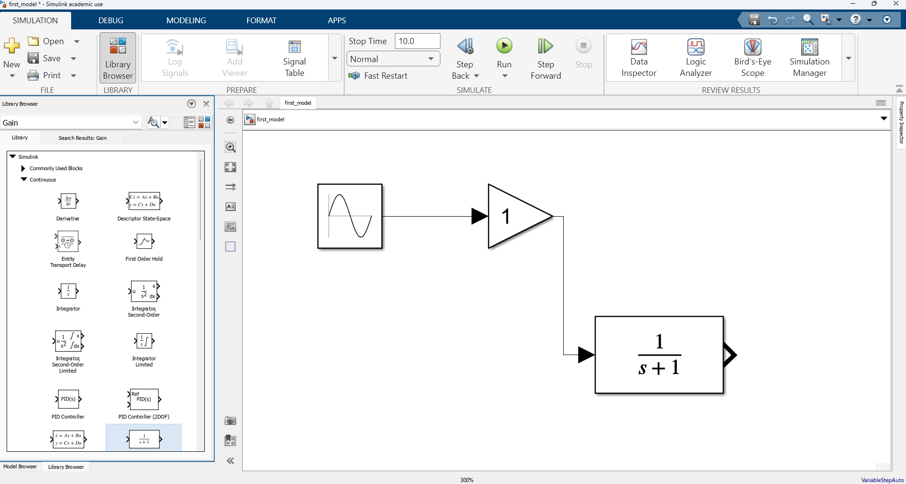
Step 3: Add Blocks
Signal Conditioning Blocks:
Add a Gain block from the "Math Operations" library to amplify the signal.
Add a Transfer Function block from the "Continuous" library to simulate a low-pass filter.

Slide 12
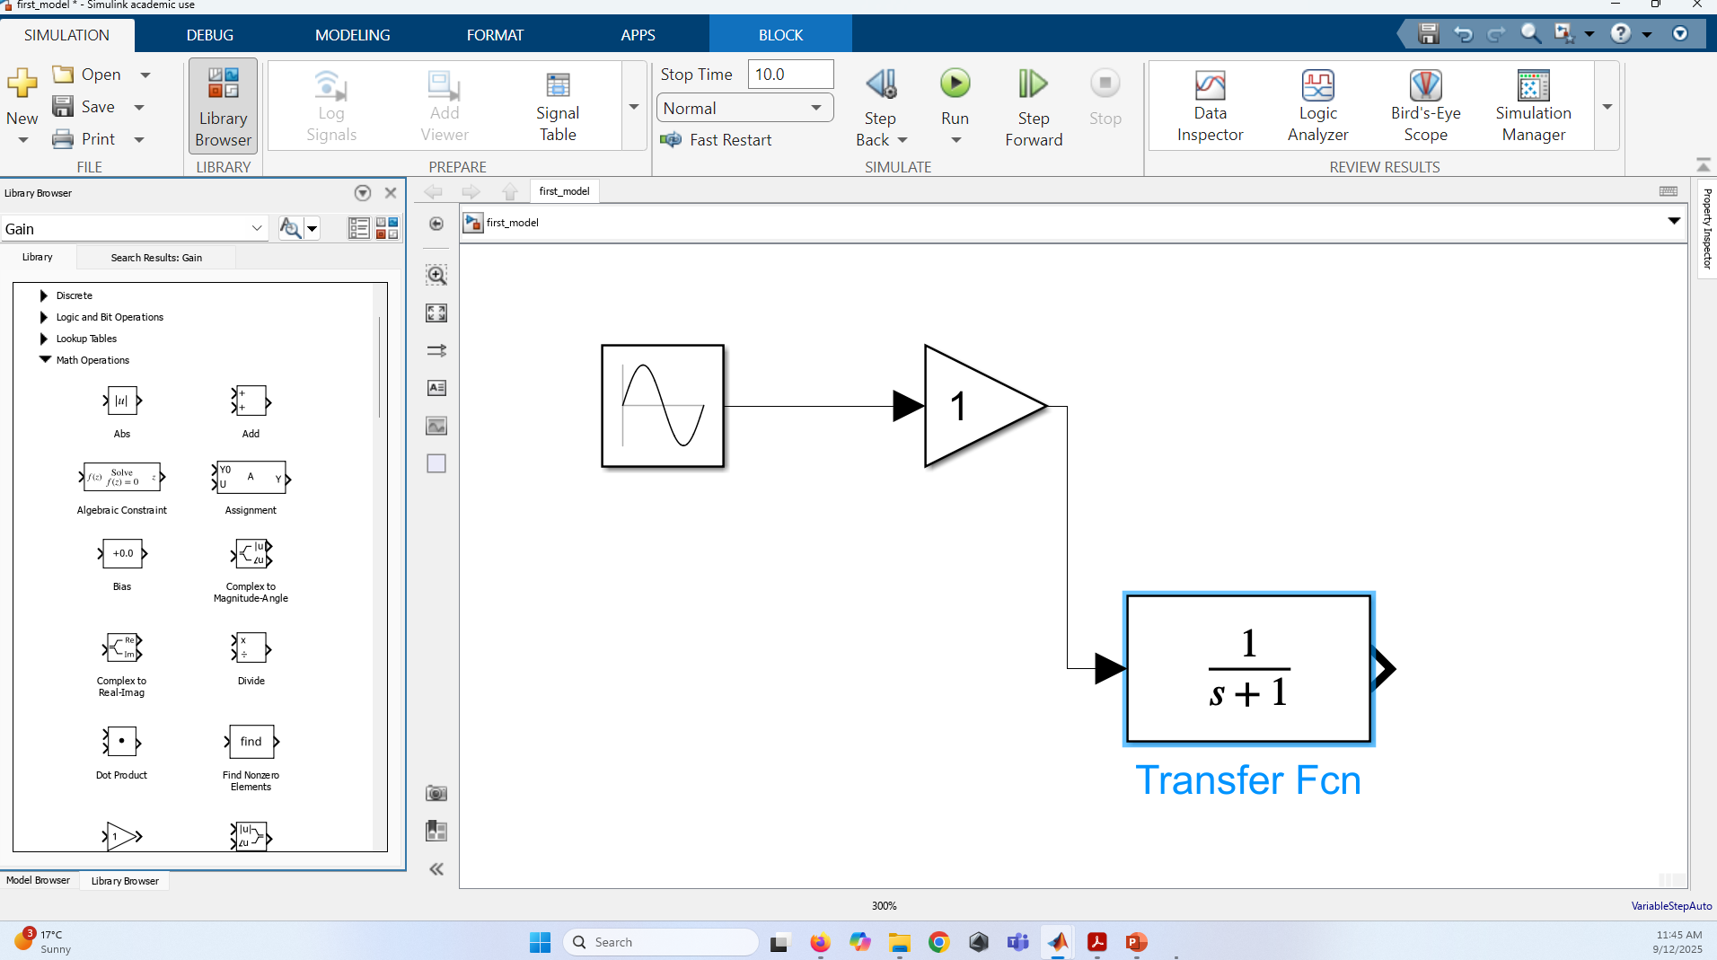
Step 3: Add Blocks
Signal Conditioning Blocks:
Add a Gain block from the "Math Operations" library to amplify the signal.
Add a Transfer Function block from the "Continuous" library to simulate a low-pass filter.

Slide 13
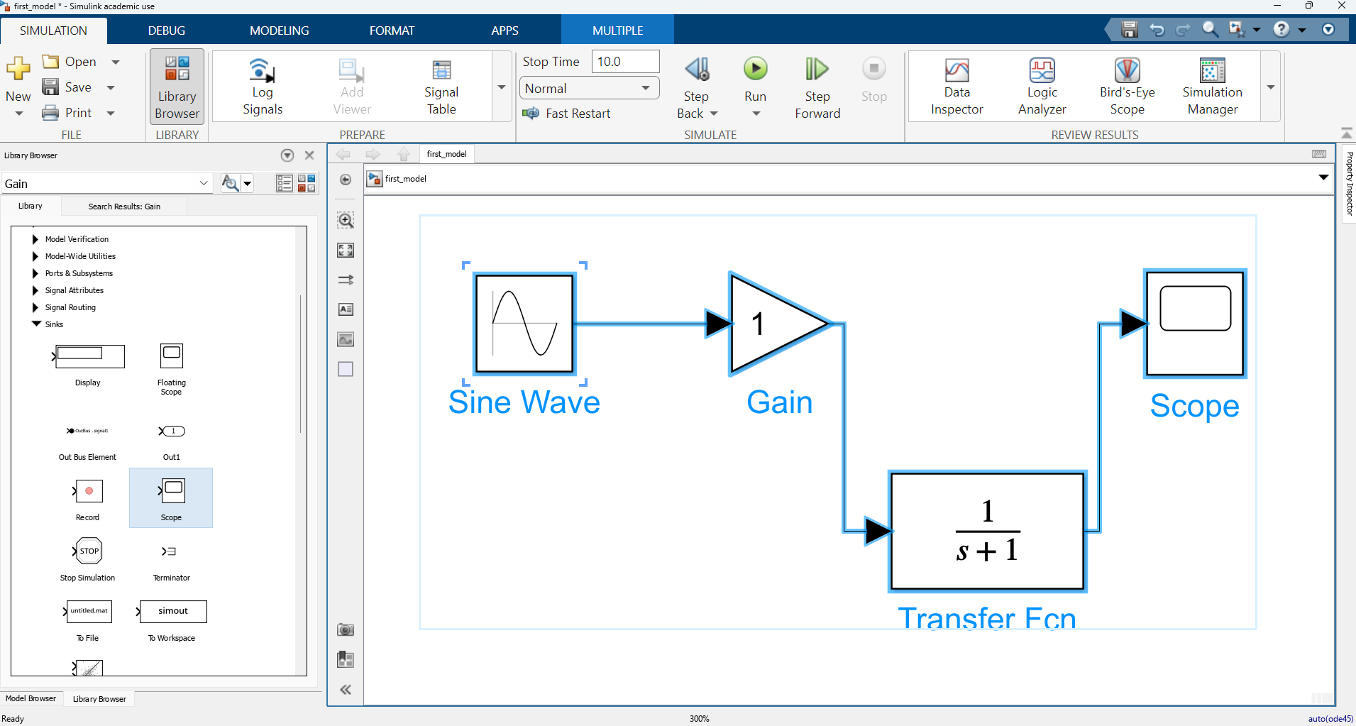
Step 3: Add Blocks
Output Block: Add a Scope block from the "Sinks" library to visualize the output.

Slide 14
Step 4: Connect the Blocks
Click on the output port of the Sine Wave block and drag to the input port of the Gain block to create a connection.
Connect the output of the Gain block to the input of the Transfer Function block.
Finally, connect the output of the Transfer Function block to the Scope block.

Slide 15
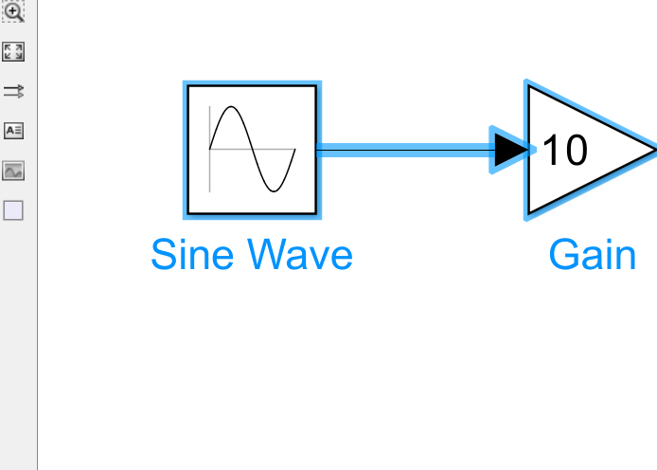
Step 4: Connect the Blocks
Click on the output port of the Sine Wave block and drag to the input port of the Gain block to create a connection.
Connect the output of the Gain block to the input of the Transfer Function block.
Finally, connect the output of the Transfer Function block to the Scope block.

Slide 16
Step 5: Configure Block Parameters
Double-click each block to set parameters:
For the Sine Wave, set the frequency and amplitude.
For the Gain block, set the gain value (e.g., 10).
For the Transfer Function, define the numerator and denominator coefficients to represent your filter.

Slide 17
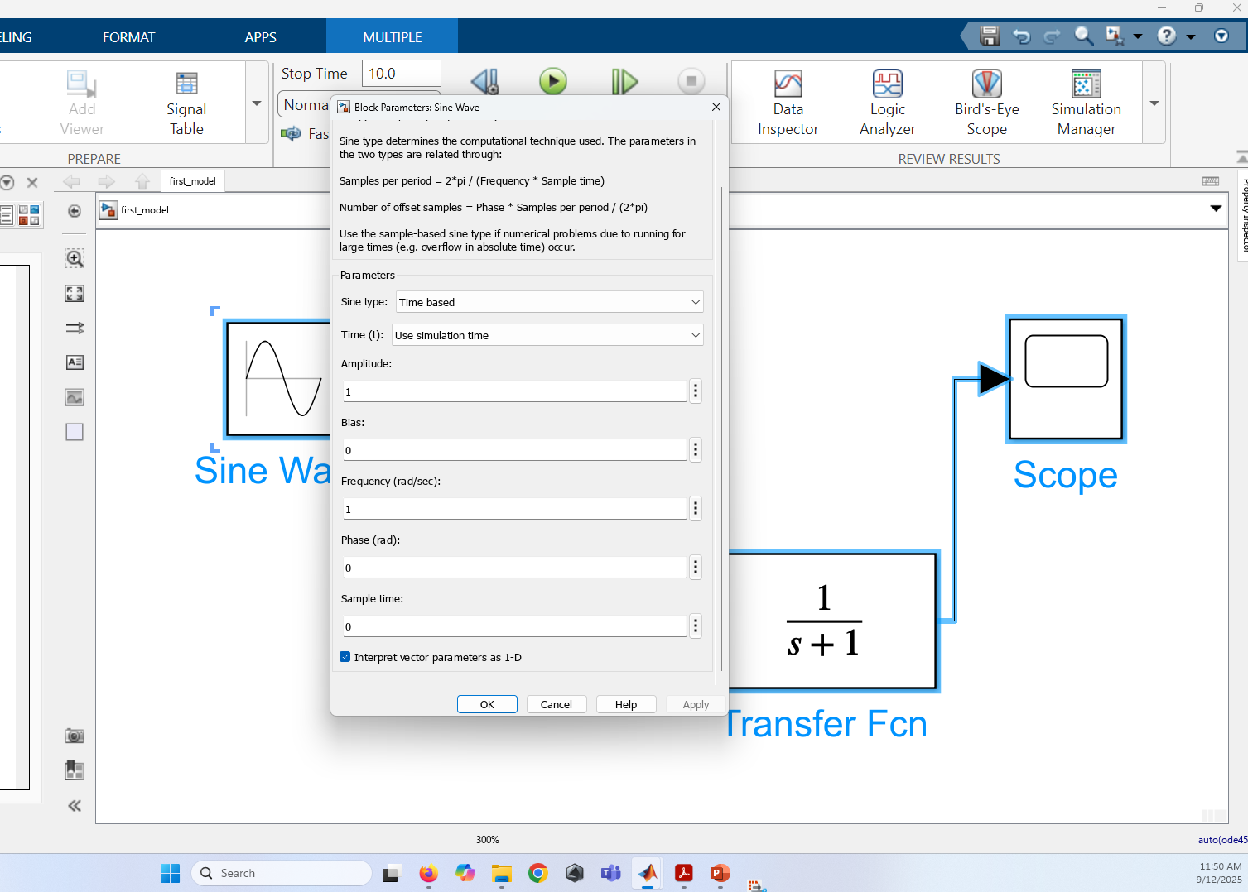
Step 5: Configure Block Parameters
Double-click each block to set parameters:
For the Sine Wave, set the frequency and amplitude.

Slide 18
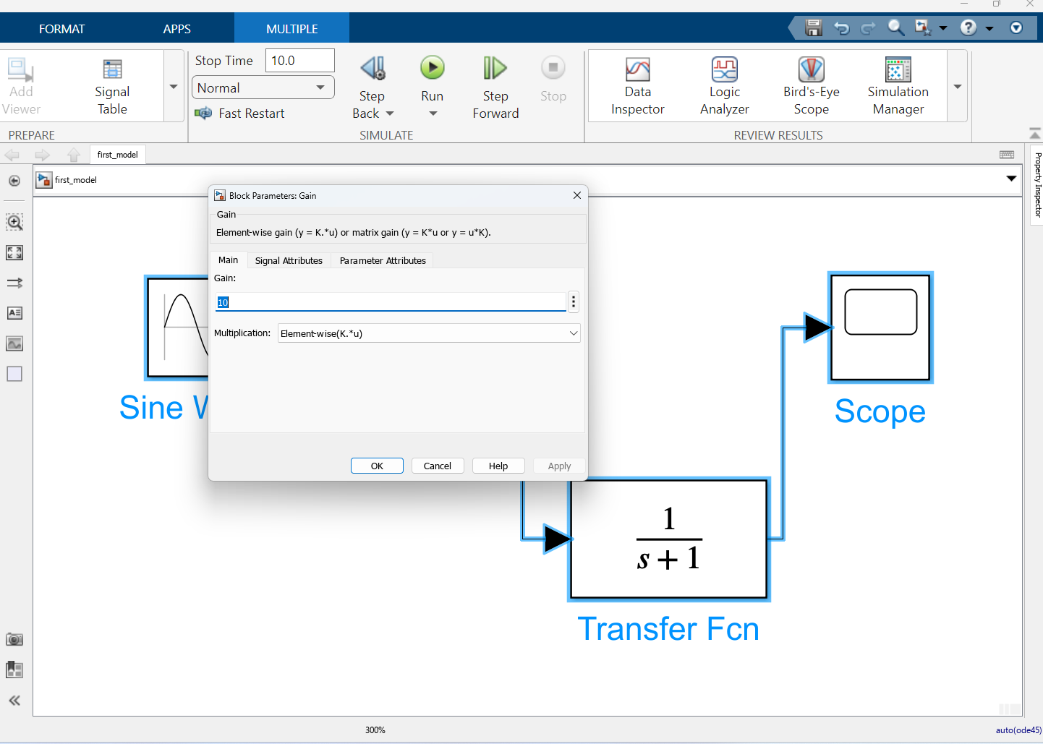
Step 5: Configure Block Parameters
Double-click each block to set parameters:
For the Gain block, set the gain value (e.g., 10).

Slide 19
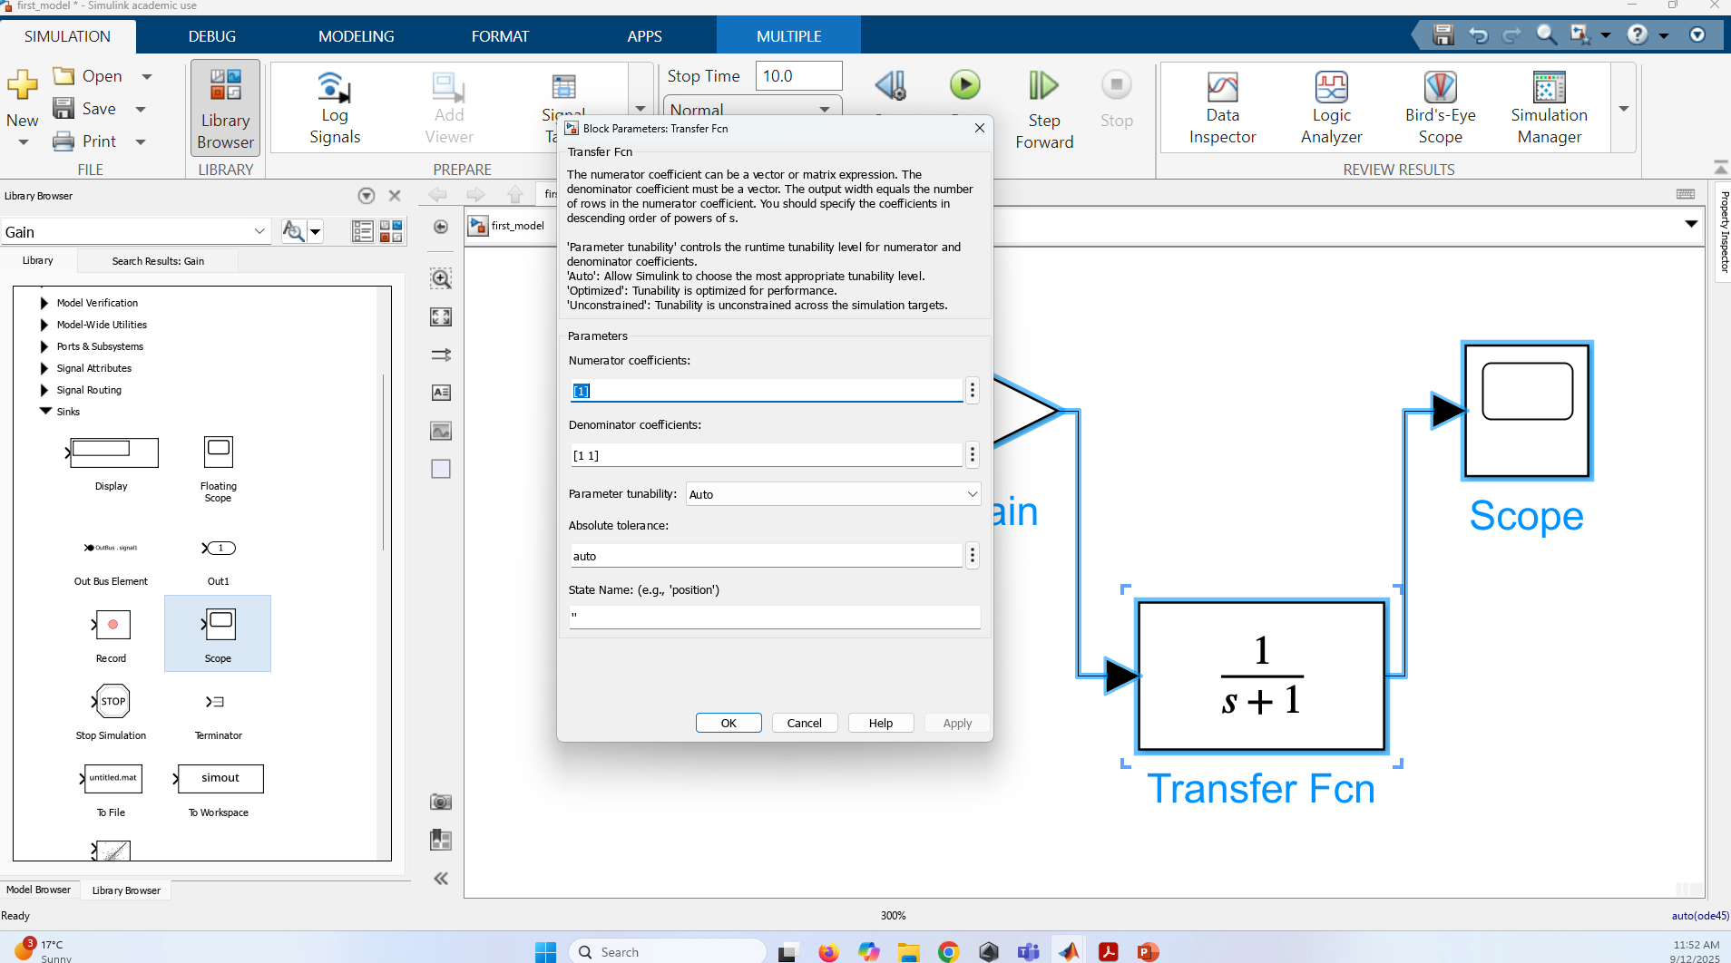
Step 5: Configure Block Parameters
Double-click each block to set parameters:
For the Transfer Function, define the numerator and denominator coefficients to represent your filter.

Slide 20
Step 7: Run the Simulation
Set the simulation time in the model configuration parameters.
Click the "Run" button (the play icon) in the Simulink toolbar.
Open the Scope block to view the output signal.

Slide 21
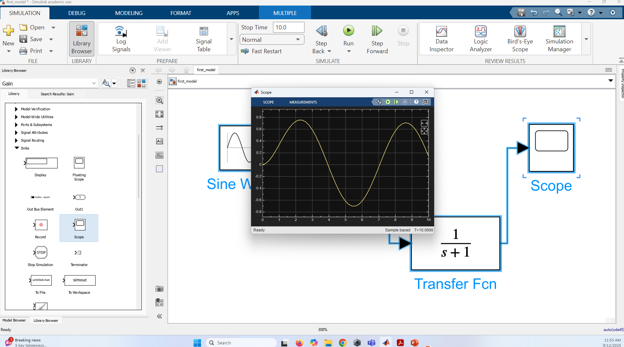

Slide 22
Thank you
Professor:
Riadh Habash, PhD, P.Eng
TA: Nader N. Joojili
Email: nnase063@uottawa.ca
Office: 4073 – Site Building

Slide 23
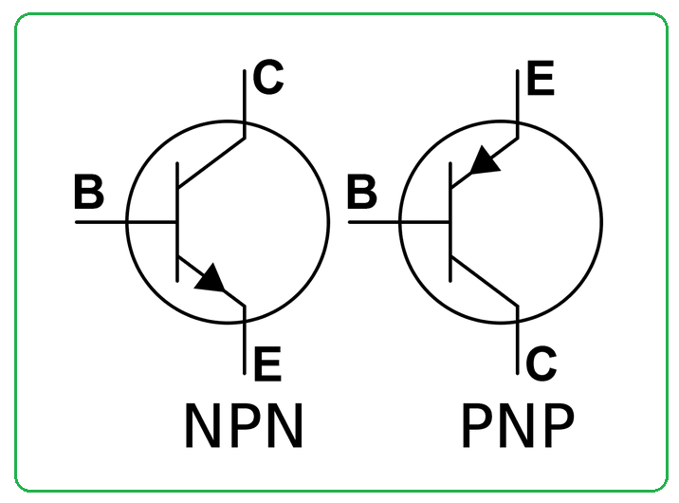
https://www.google.com/search?client=firefox-b-d&sca_esv=aa04d796f8c6ba14&sxsrf=AE3TifNksCDSV_KNQXLxx6cs70Cwb1IqCQ:1757426293327&udm=2&fbs=AIIjpHxU7SXXniUZfeShr2fp4giZ1Y6MJ25_tmWITc7uy4KIeiAkWG4OlBE2zyCTMjPbGmMU8EWskMk2JSE__efdUJ3x-dd8PyEzi5Y9BtPQcYyUvzr2KfVWYsGPotCqWnv5worxWZ5MvqwK1VLAsWVoI5-0OQVY3-Uai217hA4vqxWTmmgzjoG-zzCPz6hn6TO85Ll-a71g0gTxVukM8fqwXWBNlapLPQ&q=BJT&sa=X&ved=2ahUKEwiL47qP68uPAxU5DTQIHSekJbwQtKgLegQIGRAB&biw=1080&bih=1733&dpr=1#imgrc=K2QtsBoR-qrnbM&imgdii=lWDMQoB-fFakCM
Notes:
BJT stands for Bipolar Junction Transistor, a semiconductor device that amplifies or switches electronic signals. It uses both electrons and "holes" as charge carriers and has three terminals: the base, collector, and emitter. A small current at the base controls a larger current flow between the collector and emitter, acting as a sort of current-controlled valve. BJTs can be NPN or PNP and are used in applications ranging from amplifiers to switches in various electronic circuits and harsh industrial environments

Slide 24
Difference between the PNP and NPN transistors
https://components101.com/articles/understanding-bjt-transistor-and-how-to-use-it-in-your-circuit-designs
Notes:
The difference between the PNP and NPN transistors is that the arrow mark at the emitter end if you have noticed, the arrow in the PNP transistor is mentioned as moving from the emitter to the base whereas in the NPN transistor the arrow will be moving from the base to the emitter. The Direction of the arrow represents the direction of current flow in the transistor, in PNP the current will be flowing from emitter to base, similarly in the NPN transistor current will be flowing from the base to emitter. https://components101.com/articles/understanding-bjt-transistor-and-how-to-use-it-in-your-circuit-designs

